Slide 1

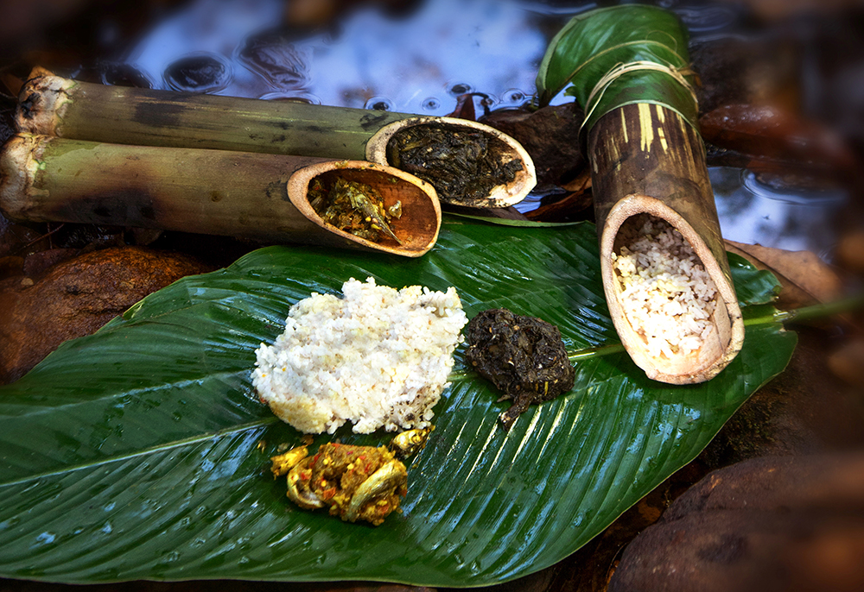
Annapurna swad aapulikicha Online food Delivery Web Application
Made By- Guide:
Aditya Pawaskar (229004) Sonali mogal
Rohan Sakale (229080)

Slide 2


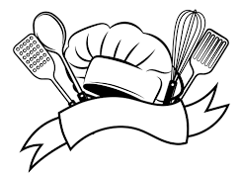

Content
Introduction
Motivation
Objectives
Screenshots
Specifications
System Requirements
Conclusions
Future Scope

Slide 3
Introduction
Annapurna Online Food Delivery is a basic one stop web application for customers, hotel managers & delivery executives.
Customers can order available food from their favorite restaurants whereas the restaurants can decide which food from their restaurant is been made available for their customers under specific food categories.
The restaurant managers can assign the food orders to the delivery executives and the delivery executives can deliver the food order and notify about delivery status.

Slide 4
Motivation
Businesses have been going through rapid changes due to the emergence of technology. Well, another reason could be a fast increasing mobile penetration and ease of use that has pushed the businesses to put mobile & web applications at the top of their priority list.
All top of it, food ordering businesses and food delivery businesses do need mobile apps, this is because the market of on-demand food delivery is thriving.
The another key catalyst is to increase convenience and transparency for both the ends i.e. customers as well as merchants.
To get extraordinary results from your business, it is important to get a customized web application for your on-demand food delivery business.

Slide 5
Objective
Convenience and Ease-The first one has to be the ease and the comfort that the food delivery apps deliver to the customers.
Time Savior-with food delivery apps, it is way easier to save time and effort to order your favorite food with just a few clicks.
Money-Saving Deal-The promo offers, discount coupons, special deals, and some exclusive offers will always help in saving your money while enjoying the best of the foods in the town.
Digital Ordering System -With digital versions of menu cards available now, it is way simpler for the customers to browse different cuisines and get it at the comfort of their homes in no time.
Accelerated Customer Engagement & Boost in Sales

Slide 6
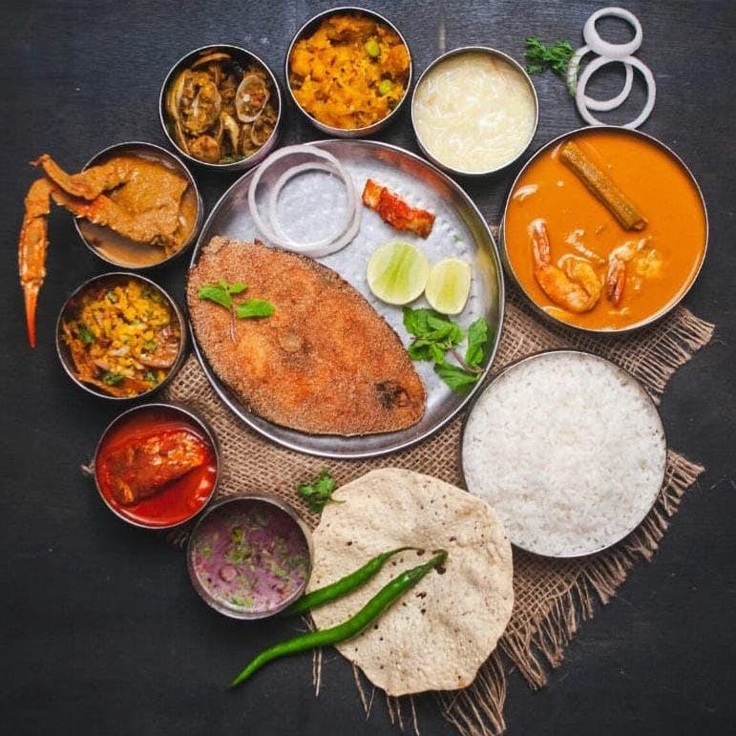
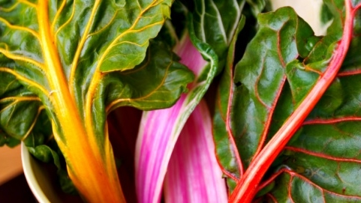
Technology
Backend
Database
FrontEnd
REACT

Slide 7
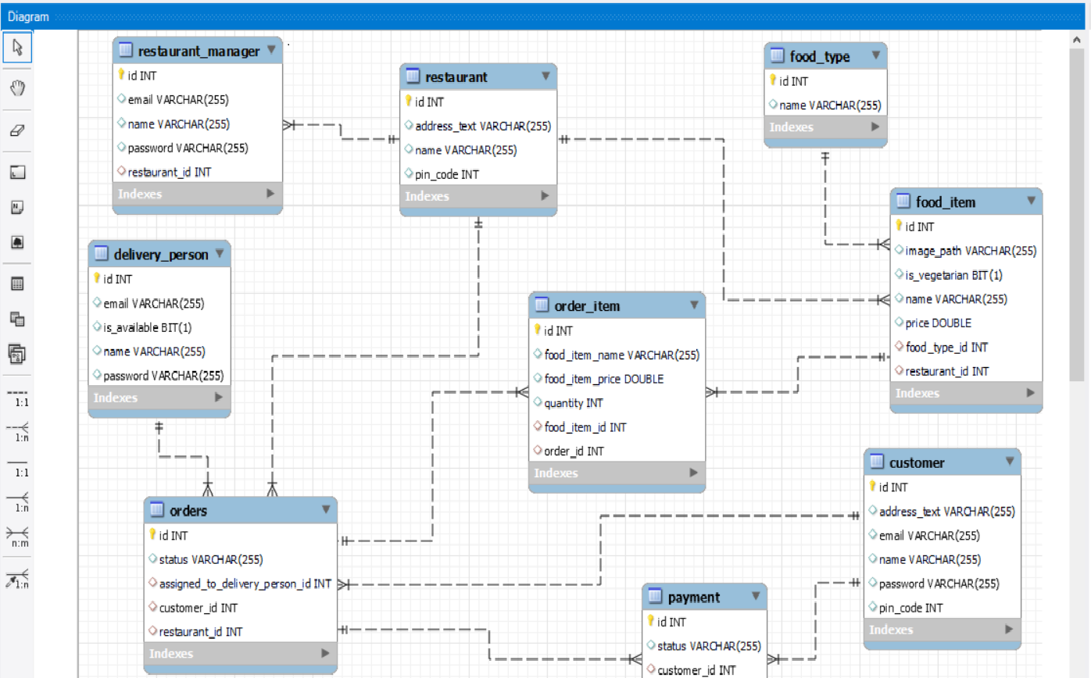

ER Diagram (MySQL generated)

Slide 8
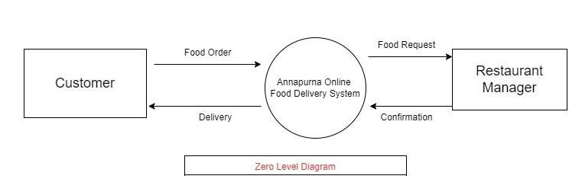
Zero Level diagram

Slide 9
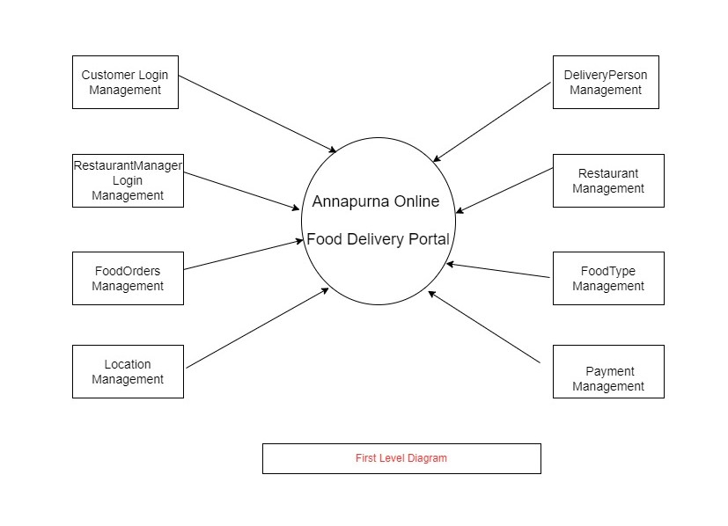
First level diagram

Slide 10
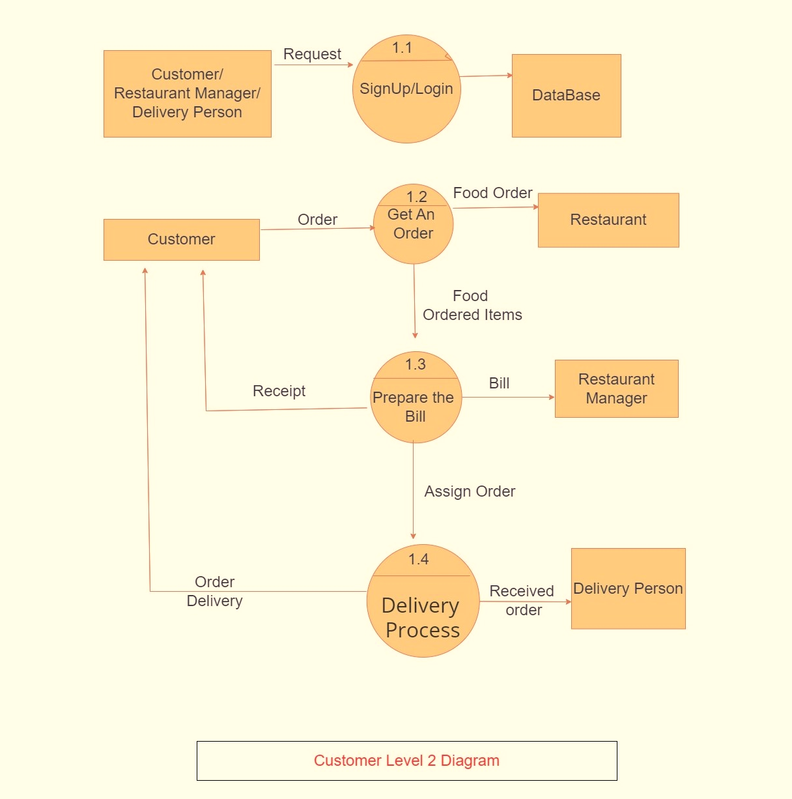
Customer second level diagram

Slide 11
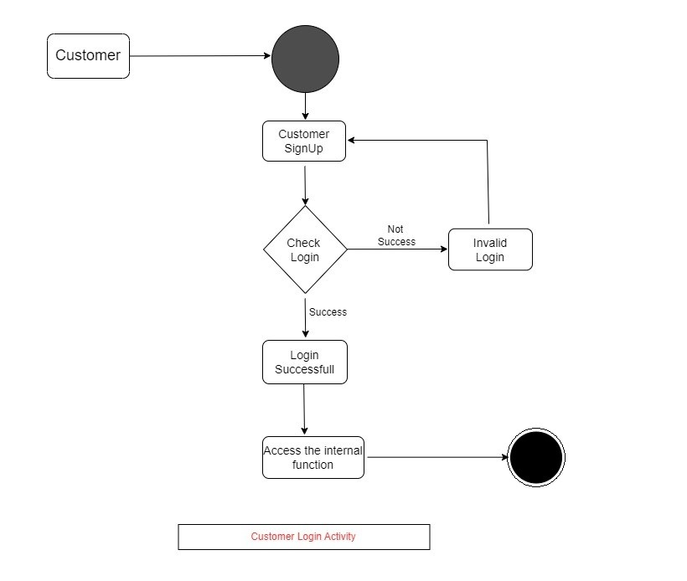
Customer activity diagram

Slide 12
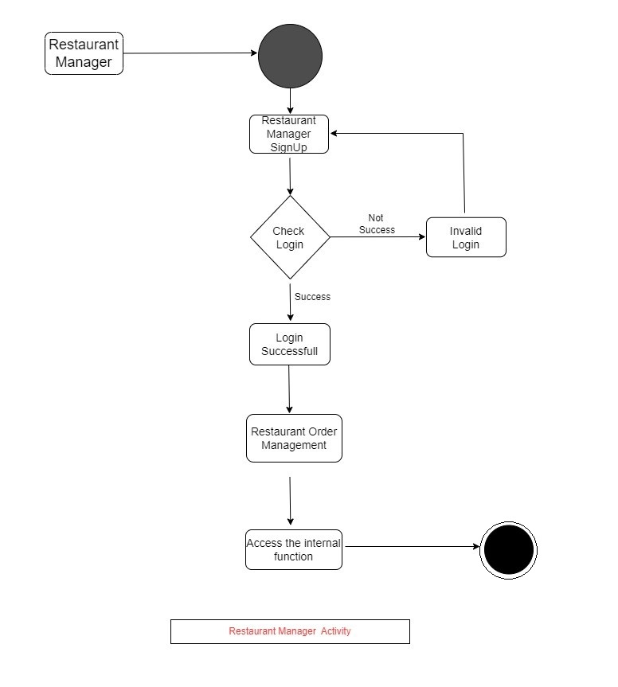
Restaurant manager activity diagram

Slide 13
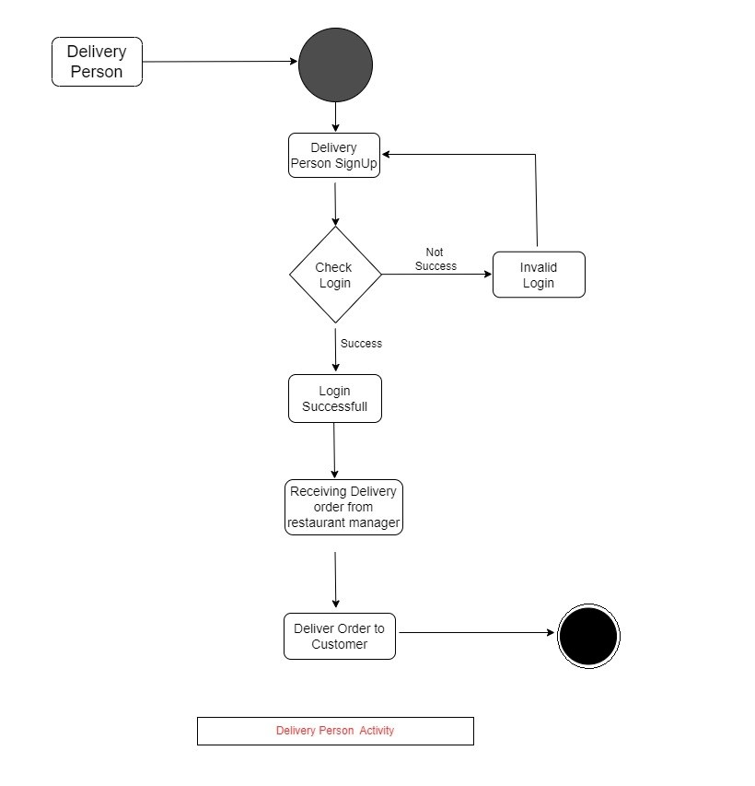
Delivery person activity diagram

Slide 14
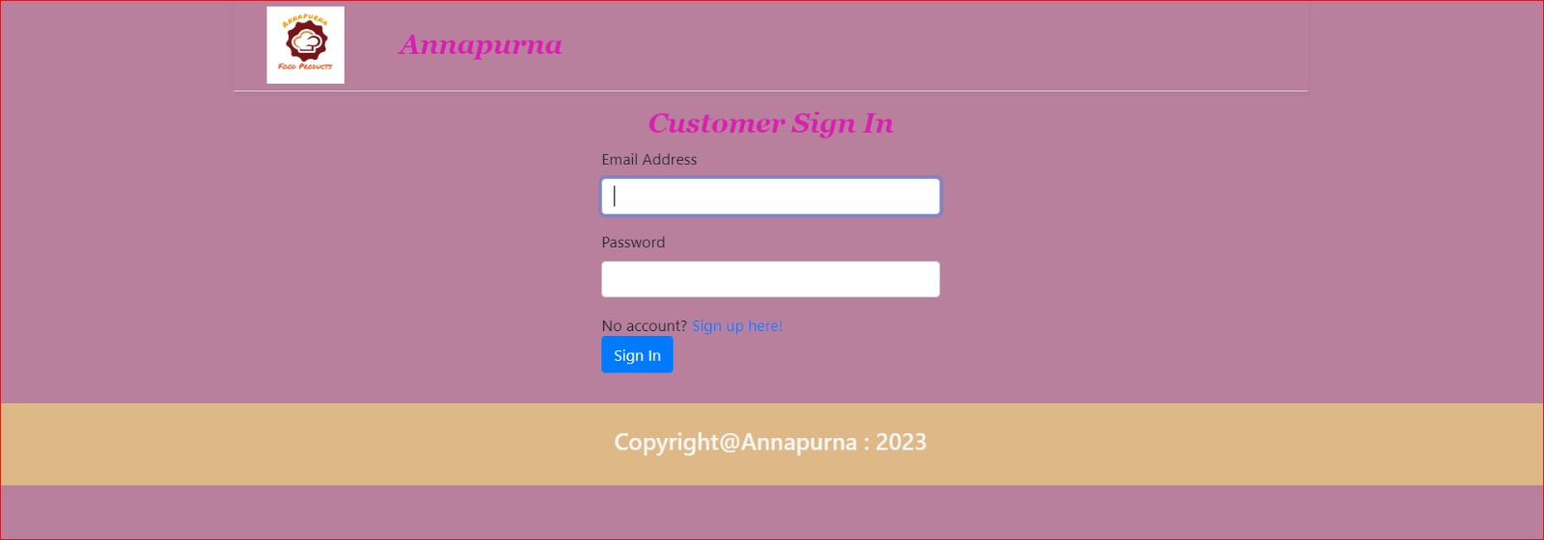
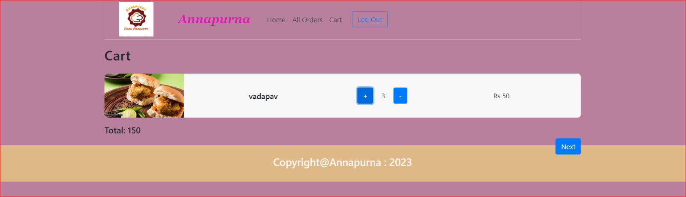
ScreenShot

Slide 15
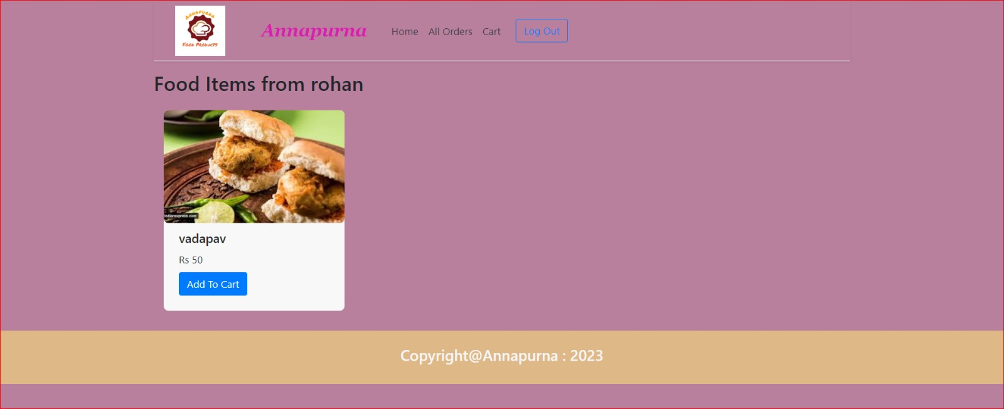
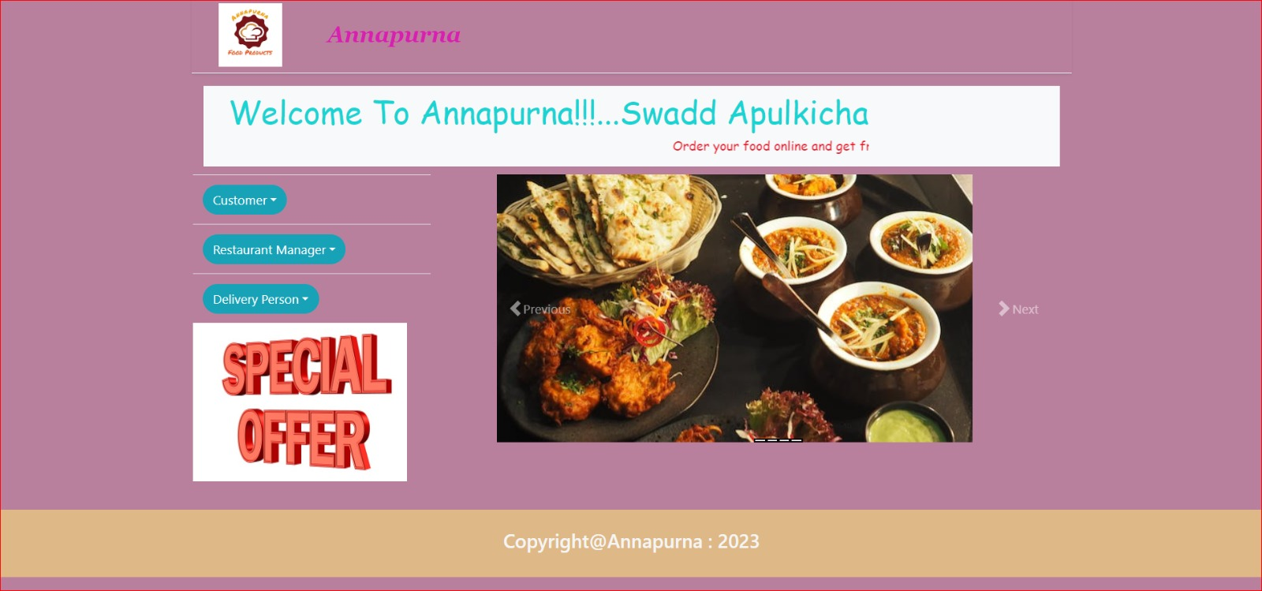
ScreenShot

Slide 16
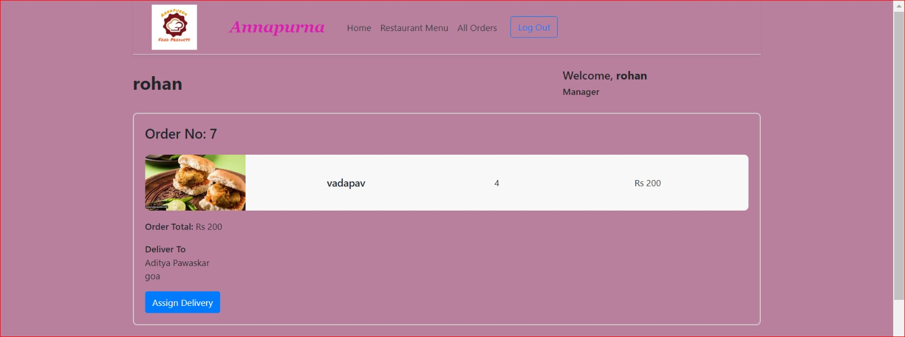
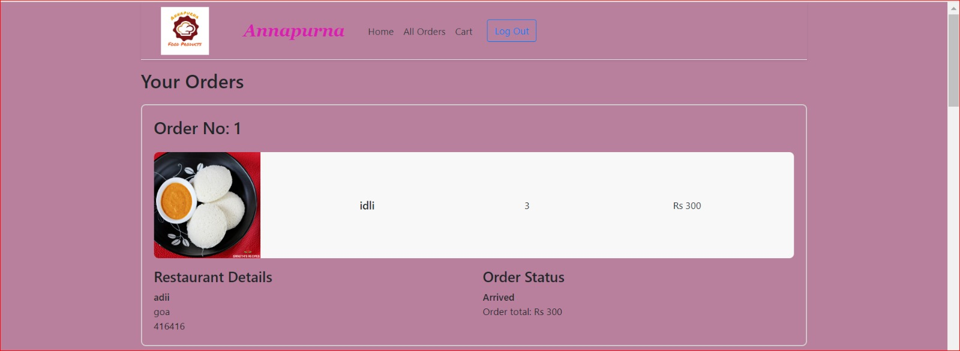
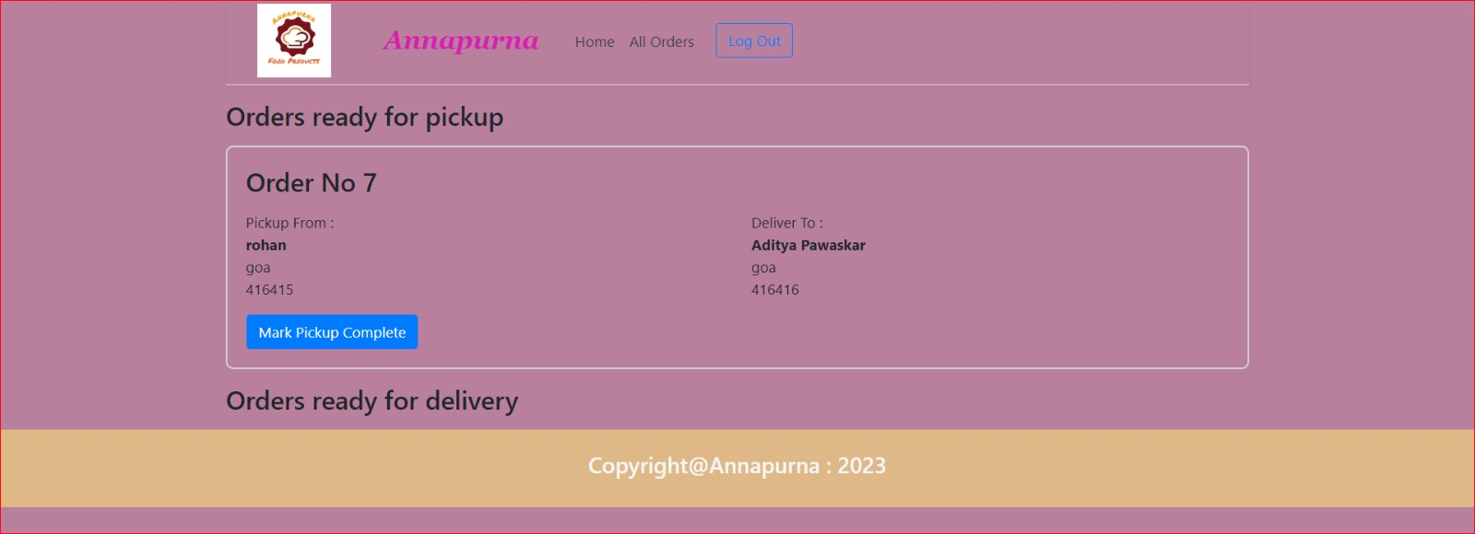
ScreenShot

Slide 17
System requirements
Server side
Client Side
Processor: Intel i3 8th gen & above
HDD : 500gb & above
RAM :4gb & above
OS: Windows 10 & above
Database :MySQL
JDK 11 & above
Eclipse IDE
Visual Studio Code
Latest Browser
Chrome / Edge /Mozilla FireFox,etc
RAM :4gb & above
OS: Android / Windows 10 & above
Stable Internet Connection

Slide 18
Conclusion
With the help of this system, people can easily order the food. It can also ensure that the people do not waste their precious time and use their time productively in the other works. In long run, this will ensure that it helps to reduce labour cost. This system proves to be more cost effective and reliable over other systems.
This project can later be expanded on a larger scale. It is developed for restaurants to simplify their routine managerial and operational task and to improve the dining experience of the clients. This also helps the restaurant owners develop healthy customer relationships by providing reasonably good services. The system also enables the restaurant to know the items available in real time and make changes to their food and beverage inventory based on the orders placed and the orders completed.

Slide 19
Future Scope
This Online Food delivery web application can be enhanced further by adding
live tracking system
review and ratings Feedback system for detailed analysis.
Real time payment system
Note: The software is flexible enough to be modified and implemented as per future needs and requirements.

Slide 20
References
https://www.baeldung.com/spring-angular-ecommerce
https://medium.com/@ravindersengar/end-to-end-design-of-a-food-delivery-app-like-zomato-or-swiggy-52b96f3a635f
https://medium.com/javarevisited/lets-develop-shopping-cart-for-ecommerce-app-8e57a9ab4868
https://github.com/coniferousdyer/Food-Ordering-Portal.git

Slide 21

Thank you
adityapawaskar8@gmail.com
rasakale2196@gmail.com

